Slide 1

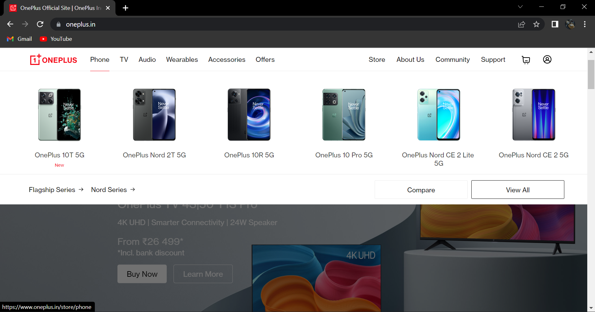
PROJECT NAME : ONEPLUS WEBSITE

Slide 2
Shaik Abdul Subhan Fazil
Overview
TECHNOLOGY COMPANY. Headquartered in Shenzhen, Guangdong, OnePlus is a Chinese smartphone brand founded by former Oppo vice-president Pete Lau and Carl Pei in December 2013. The company is one of the three subsidiaries of BKK Electronics, the other two being Oppo and Vivo.

Slide 3
Goals
Sign In and Sign Up page
Home Page
Account page
Cart Page
History
TECHNOLOGY COMPANY. Headquartered in Shenzhen, Guangdong, OnePlus is a Chinese smartphone brand founded by former Oppo vice-president Pete Lau and Carl Pei in December 2013. The company is one of the three subsidiaries of BKK Electronics, the other two being Oppo and Vivo.

Slide 4
Technologies used in oneplus website :
Front-End :
Html
Css
Bootstrap

Slide 5
https://sasfazil.github.io/2nd-project-document/

